Slide 1

Intro to Development
Set up an effective development environment
Dineth Marlin Ranasinghe
@MarlzRana
Notes:
This will be the slide that will be displayed as members walk into the theatre

Slide 2
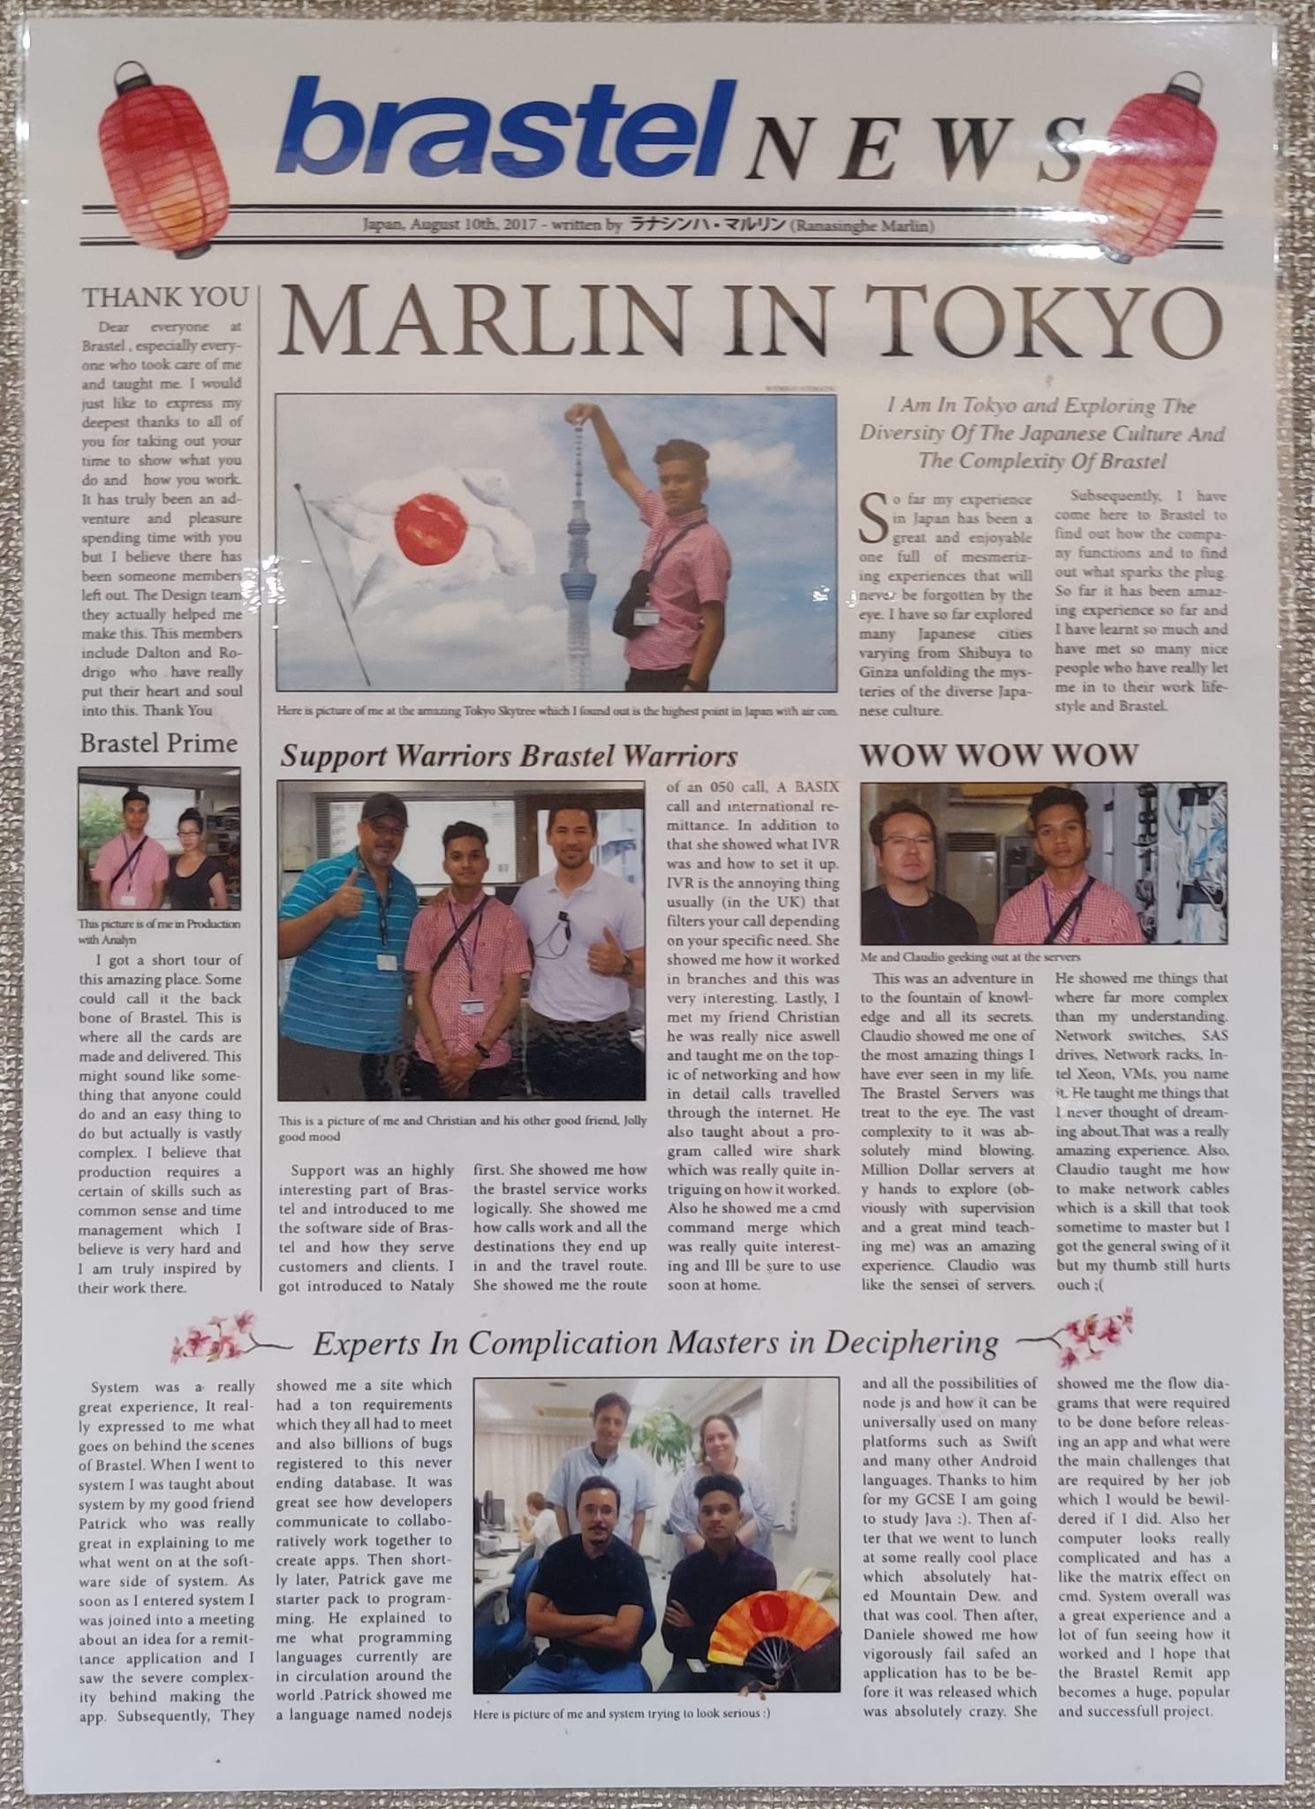


Who am I?
Competitive Programming Lead
MarlzRana
dineth-marlin-ranasinghe
Notes:
Here I will talk about:
How I am the competitive programming lead
A bit about my professional background
What I am here to do at GDSC
How to get in contact with me regarding any questions (also mention business card at front)

Slide 3
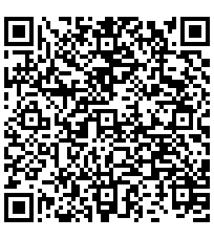
RSVP
Scan the QR code and register
In order to know who to give certificates to we need to a list of attendees

Slide 4
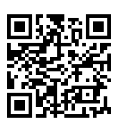
Discord
Please join our server
All resources that we will be using today will be found on our Discord server

Slide 5
protected void onTryUpdate(int reason) throws RetryException {
// Do some awesome stuff
int foo = 15;
publishArtwork(new Artwork.Builder()
.title(photo.name)
.imageUri(Uri.parse(photo.image_url))
.viewIntent(new Intent(Intent.ACTION_VIEW,
Uri.parse(“http://500px.com/photo/" + photo.id)))
.build());
scheduleUpdate(System.currentTimeMillis() + ROTATE_TIME_MILLIS);
}
Notes:
Use this slide as a motivation:
Explain that here is a slide of code
Engage the audience ask them these questions:
What programming language is this?
Does anyone know what this piece of code do?
Looking at code and identifying what a piece of code does is all great and all but how do we actually set ourselves up for development and start writing some code?
Spoiler alert: We won’t necessarily be writing code in this workshop, but we will setting you guys up with the necessary foundation in the form of a professional software developer environment to write your own code!

Slide 6
What will we be covering?
How to install a Linux subsystem for Windows user
How to install an alternative Unix package manager
How to convert to zsh and use oh-my-zsh
Install a nerd font (advanced)
How install p10k and customize your shell (advanced)
Additional zsh plugins (advanced)
Introduction to Git
Notes:
Mention:
We will try to get through all the topics on the slide
Roughly explain each one
Also explain advanced are setup steps that aren’t really that tricky but strictly not necessary but extremely useful and probably will be of utility to the second year cs students and above

Slide 7

Why Unix?
The global development operating system
Notes:
Mention:
Unix is a an operating system that most operating systems are build on top of and it is what is used within the field of hardware and software
Operating systems influence code behaviour, hence we want a global operating system that all developers can use to ensure that their code runs effectively across a variety of development machines hence most servers these days are running a unix based operating system, so it’s worth it to develop on a unix based operating system so that we can ensure our code will reliably run on actual real production-level (meaning customer facing) servers
Also unix commands, are considered “standard commands” meaning that any systems you interface will most likely adopt these “standard commands” so it’s worth using them in your daily life to familiarise yourself with their operation
Additionally there are technologies such as Docker that require a unix environment
Mention that MacOS and Linux are based on Unix which most flavours of all development operating system are based upon
Clearly mention that Linux and MacOS are flavours of Unix, hence we can use the word unix to refer to both of them
Analogy of ice creams: The ice lollies have slightly different characteristics including taste and color, but they are fundamentally made up of the same stuff.
Let's get started, and mention the start is Windows only to get Windows to a UNIX environment and then once we’ve done that we can move in unison as every has a unix based terminal now

Slide 8
Linux Commands
Must know commands to navigate around
pwd: See your current working path
ls: See files and directories within the current directory
cd: change directory
mkdir: make directory
rmdir: remove director
touch: new file
sudo: admin mode

Slide 9
asdf
Java
Python
Go
OpenJDK15
OpenJDK17
2.8.2
3.6.8
1.18.7
1.19.2
Notes:
Use this slide as a motivation:
Explain that here is a slide of code
Engage the audience ask them these questions:
What programming language is this?
Does anyone know what this piece of code do?
Looking at code and identifying what a piece of code does is all great and all but how do we actually set ourselves up for development and start writing some code?
Spoiler alert: We won’t necessarily be writing code in this workshop, but we will setting you guys up with the necessary foundation in the form of a professional software developer environment to write your own code!

Slide 10

What is Git?
Open source version control system
Submit your code piece by piece
Git keeps track of changes from submission to submission line by line
Each submission is given a version number in the form of a commit signature
Incase of a mistake you can revert back to a prior submission by using the prior commit submission
Makes working in a team easier with the features included in Git such as issues and branches

Slide 11
Society News
What’s to come?
We want to host a first years hackathon!
We will soon be recruiting!

Slide 12
Perseverance is failing 19 times and succeeding the 20th.
Julie Andrews

Slide 13

Feedback
Scan the QR code
Let us know how we did and let us know what you would like to see in the future!

